Slide 1

Analyzing U.S. Traffic Accident
DATS 6103-O10
Weirui Liu

Slide 2
Introduction
Nowadays, with more and more cars on the road, how to reduce traffic accidents has become the focus of our society. This project will analyze and inference from the DateTime, location, weather condition, and point of interest in traffic accidents. Find out the factors that affect the frequency of traffic accidents. Look at how historical data can be analyzed to predict the period, road sections, weather conditions where accidents occur frequently, and how traffic infrastructure can be improved to reduce accidents.

Slide 3
Data Source
1. United State Traffic Dataset (Feb 2016 - Jun 2020) [Source]
This is a national dataset on traffic accidents in the United States. This dataset contains data on about 3.5 million U.S. instances of traffic accidents across 49 states (excluding Alaska) from February 2016 to June 2020 (only 8 cases occurring before February 2016). Each incident record details its traffic attributes, address attributes, weather attributes, point of interest attributes, and period of day attributes.
2. County FIPS Codes Dataset [Source]
This data set contains all the counties in the United States and its FIPS code. It for drawing county maps of the United States.
3. County Population (2010 - 2019) [Source]
This dataset contains all counties in the United States and its estimated population from 2010 to 2019. It for comparative analysis of traffic accidents and population relations in each county.

Slide 4
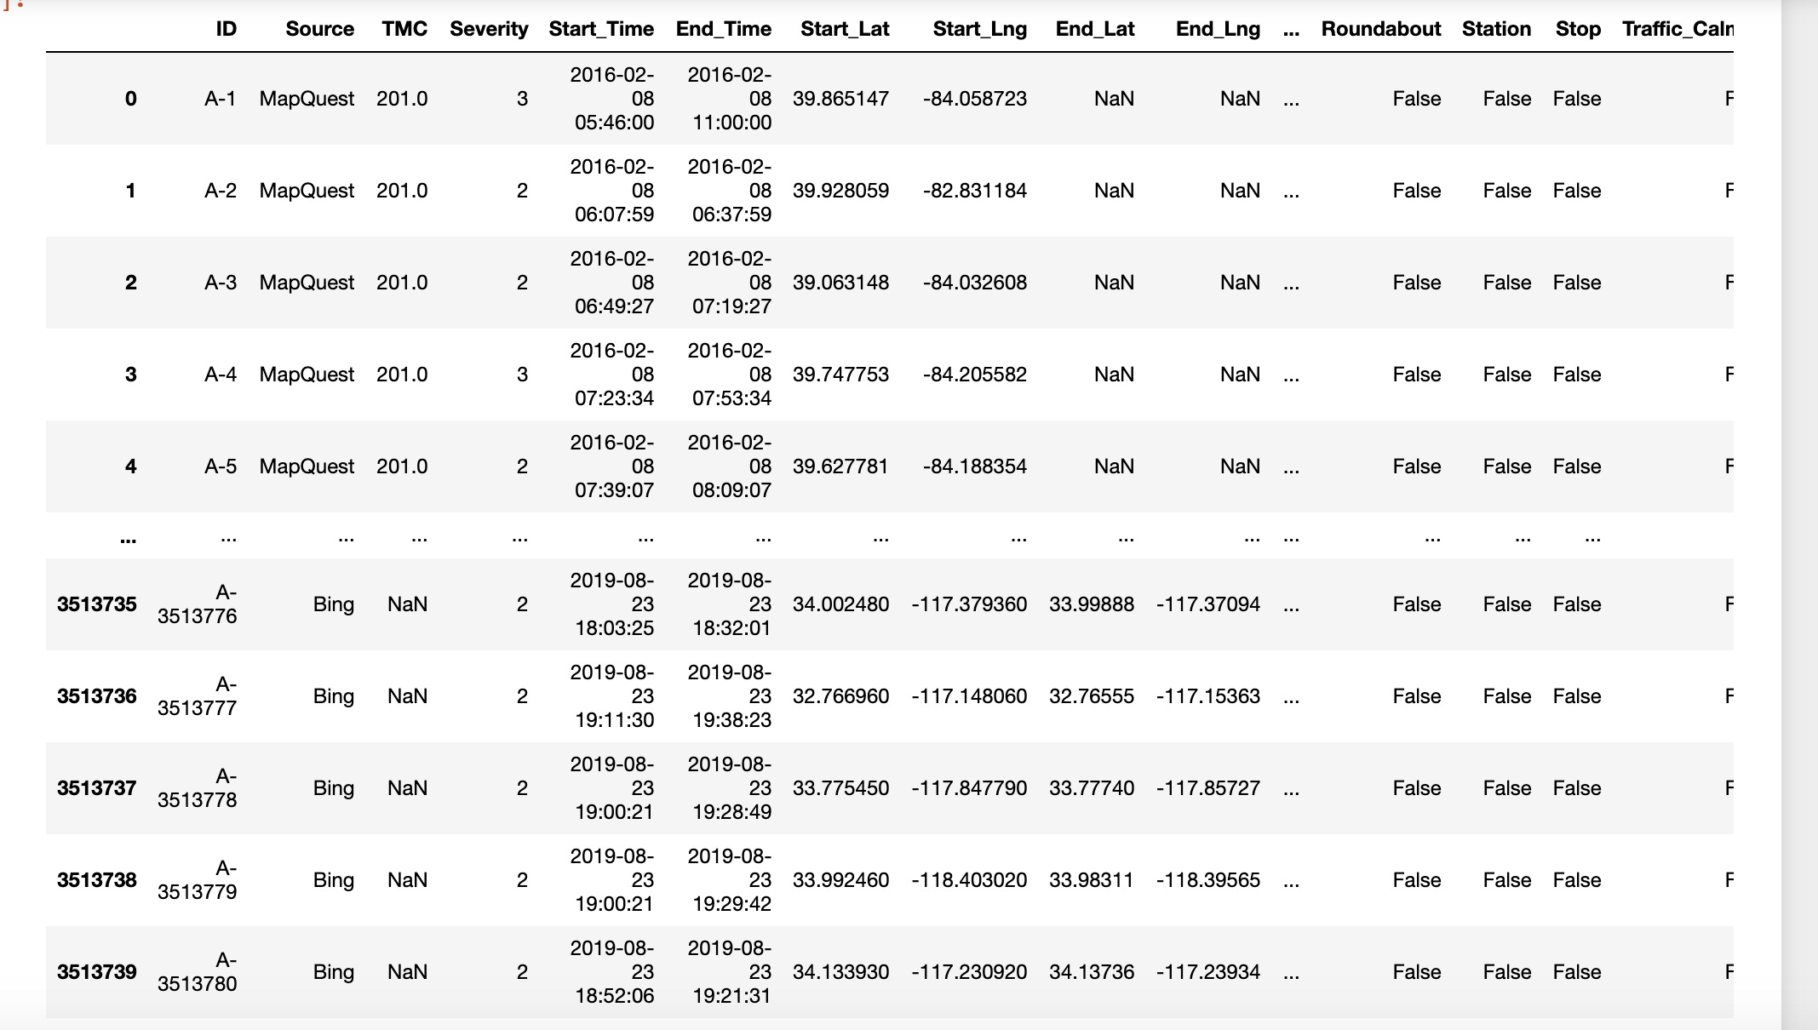
Data Cleaning and Preprocessing
Traffic Accident DataFrame

Slide 5
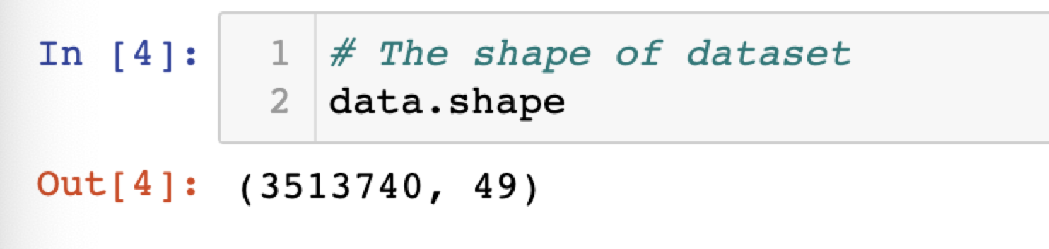
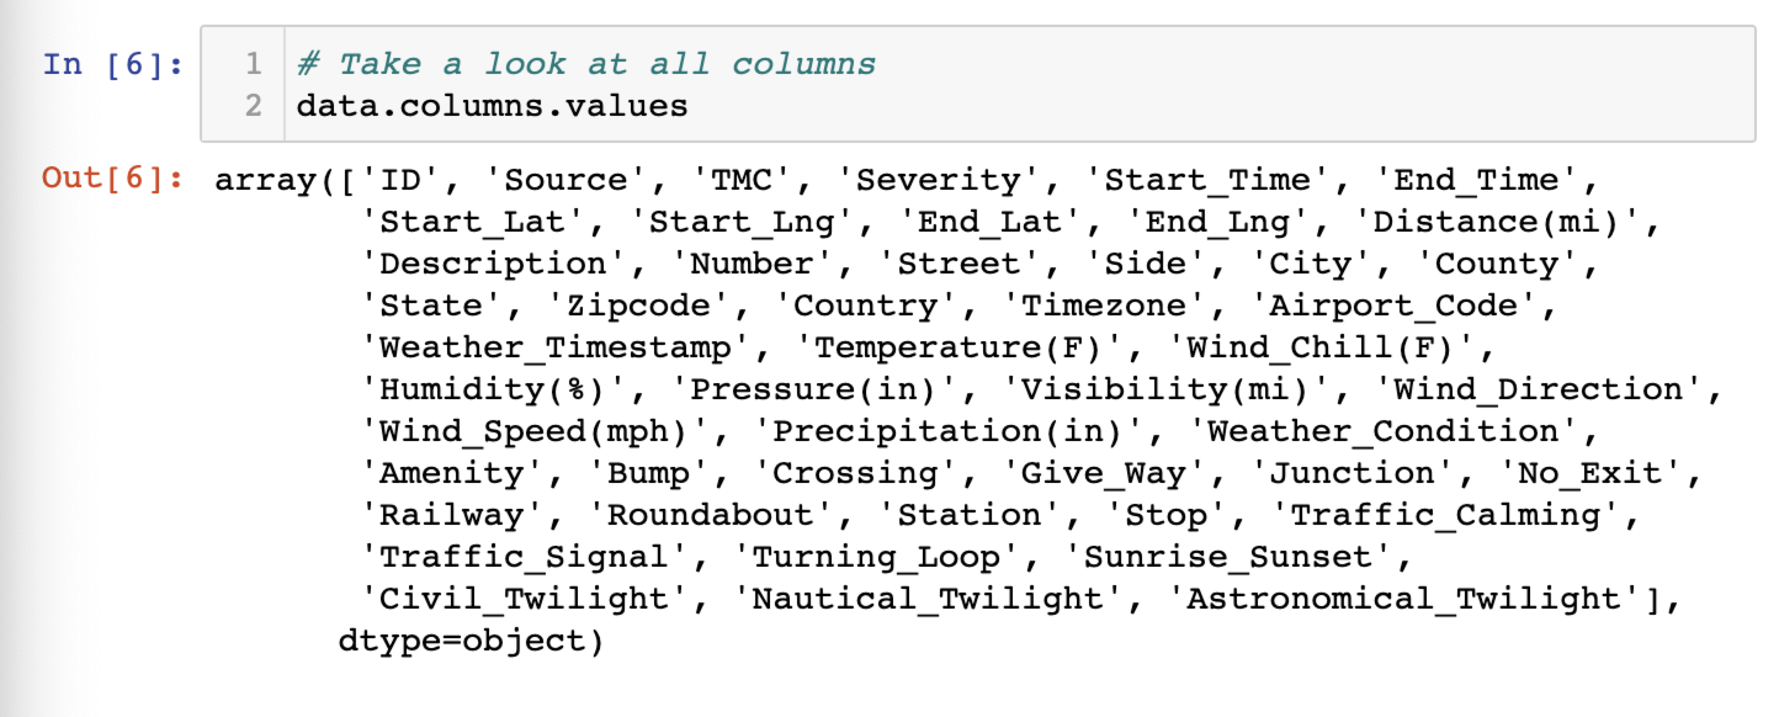

Slide 6
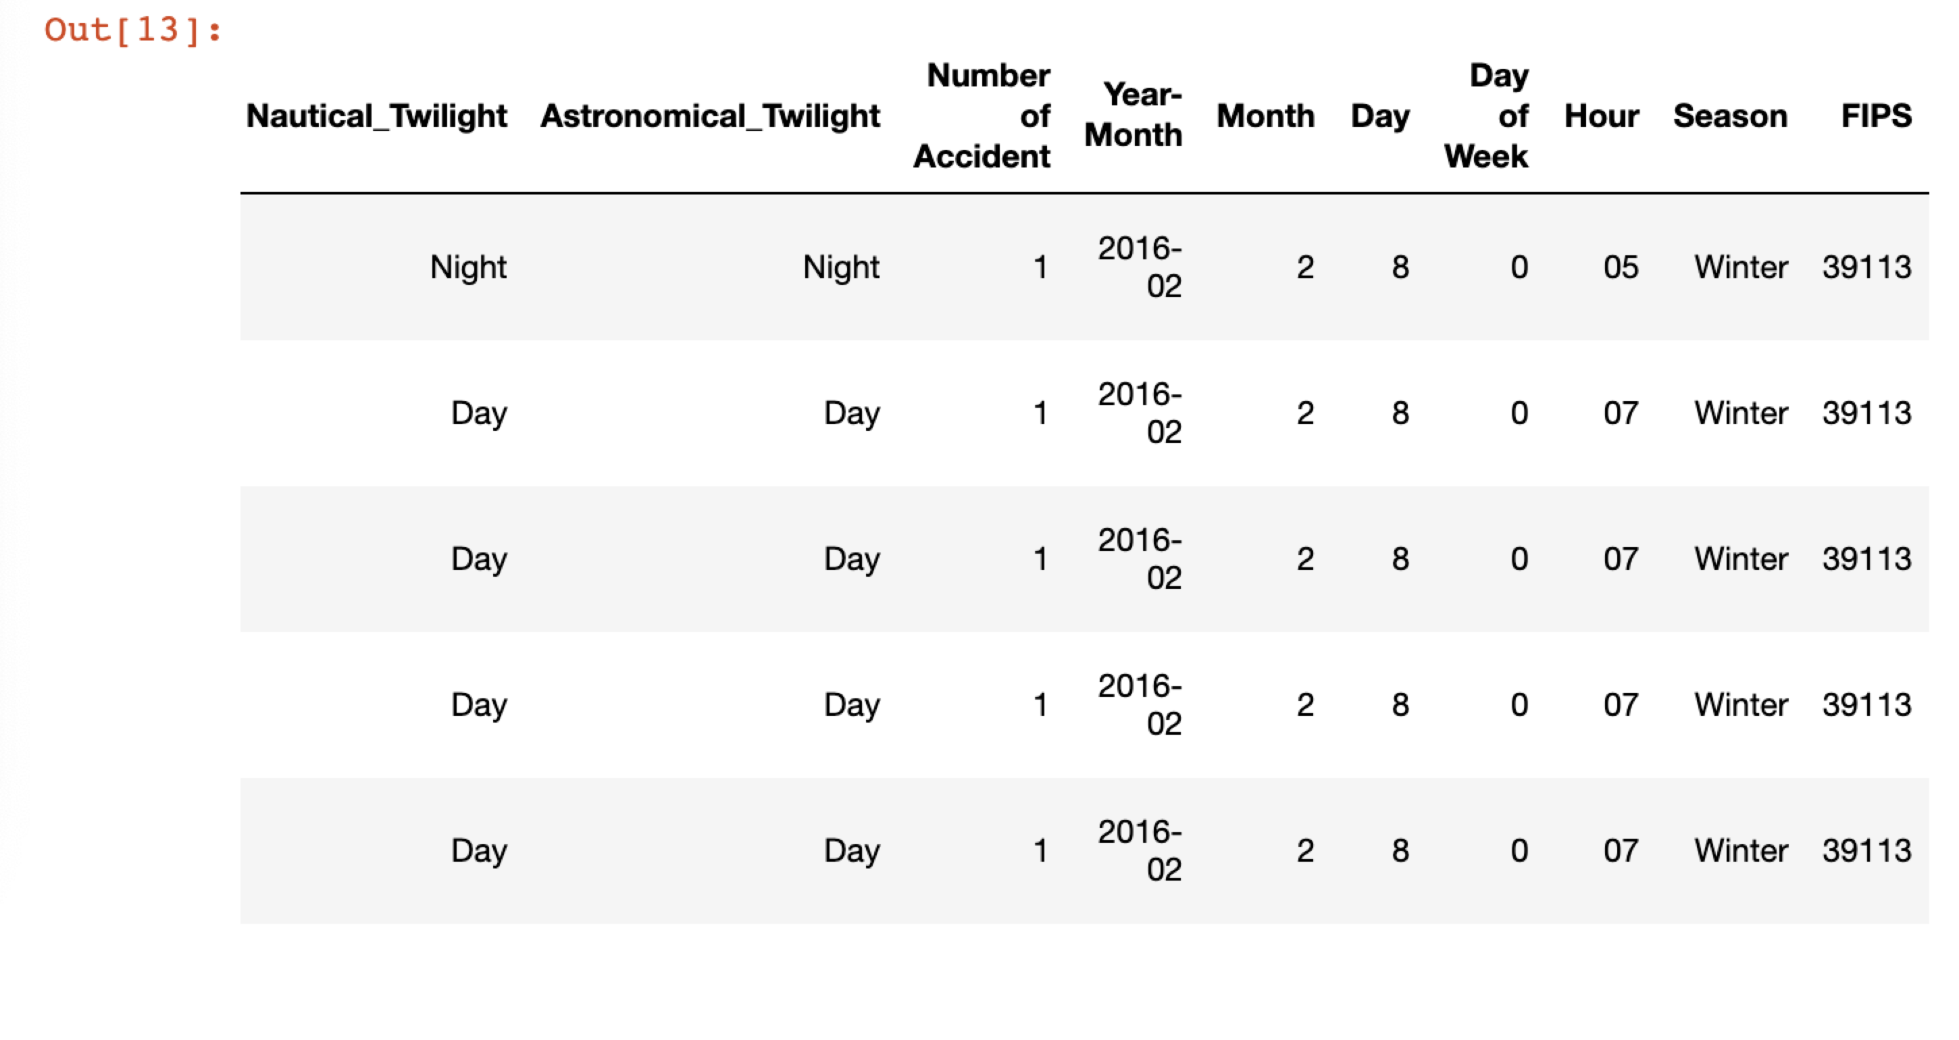
DataFrame with FIPS code

Slide 7
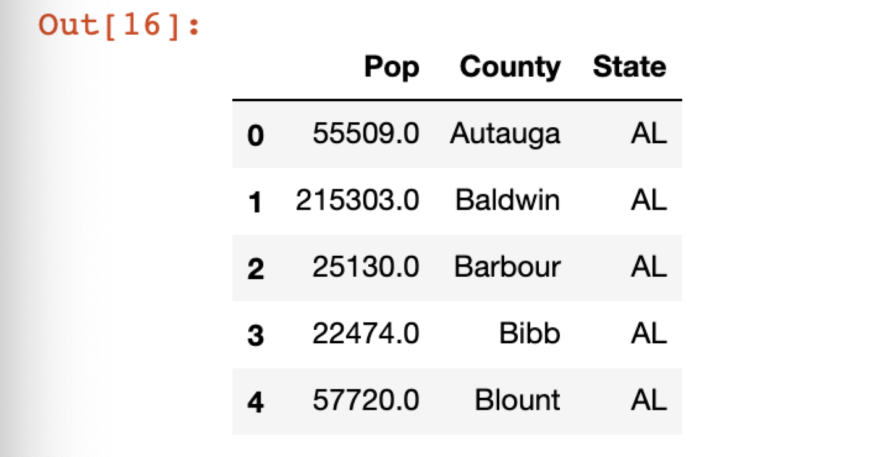
County Population Dataset

Slide 8
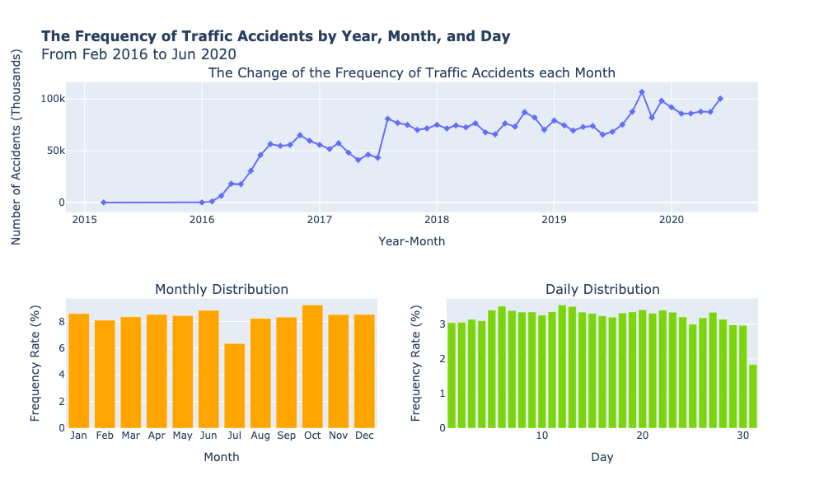
Data Exploration, Analysis and Visualization DateTime Analysis
The Frequency Rate of Traffic Accidents by Year, Month, and Day
From January 2016 to June 2020, traffic accidents in the United States showed a significant increase. Traffic accidents in the US have increased from about 50,000 per month in 2016 to nearly 80,000 per month in 2020 and even exceeded 100,000 in some months. Traffic accidents occur more frequently in the second half of each year than in the first half.
According to the monthly distribution, traffic accidents occurred more frequently in October and June, but the frequency of accidents in July was much lower than in other months. According to the daily distribution, the 12th and 13th of each month is the day with the highest traffic accidents. In contrast, traffic accidents were lower in the late each month and the first few days each month. (The 31st is lower because there is no 31st for five months every year.)

Slide 9
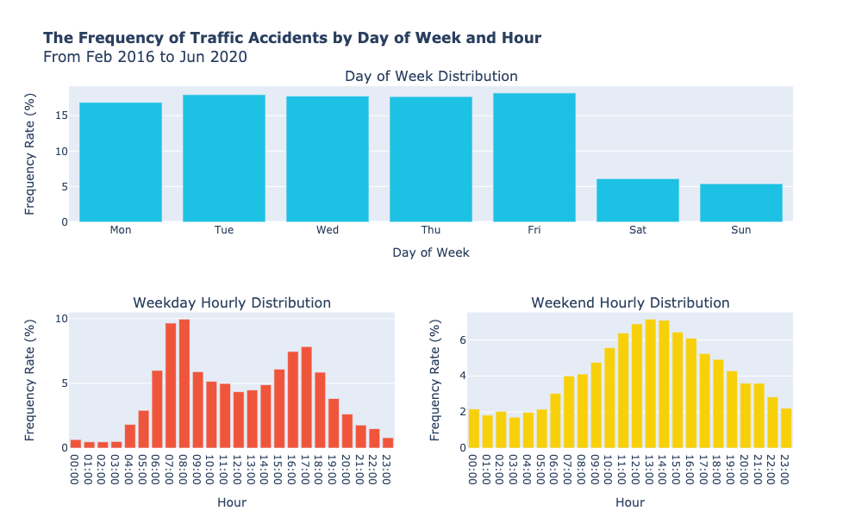
Data Exploration, Alalysis and Visualization DateTime Analysis
The Frequency Rate of Traffic Accidents by Day of Week and Hour
According to the weekly distribution, traffic accidents during the weekday are nearly 10% more frequent than those during the weekend. Accidents occur most frequently on Fridays. Because of the apparent difference between weekdays and weekends, the hour distribution diagram should be discussed separately. According to the weekday distribution, 7,8 a.m. and 4,5 p.m. are the time when traffic accidents occur most frequently. According to the distribution of weekend hours, 1, 2 p.m. on the weekend is when traffic accidents occur most often.

Slide 10
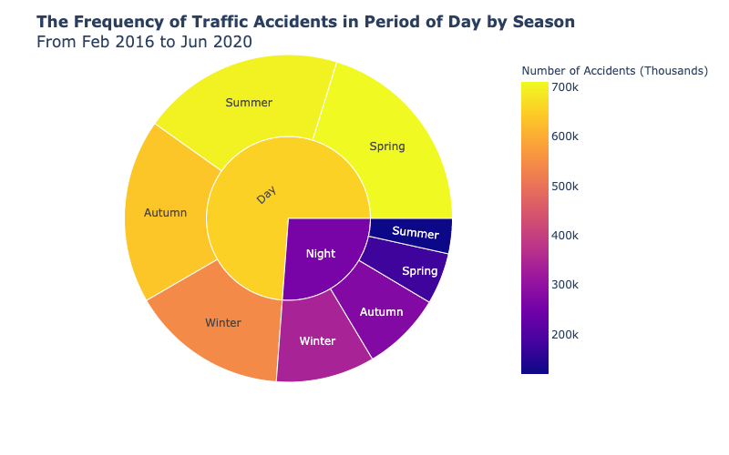
Data Exploration, Alalysis and Visualization DateTime Analysis
The Frequency Rate of Traffic Accidents in Period of Day by Season¶
Identify the day and night by sunrise and sunset. Traffic accidents frequently happen on the day. Traffic accidents occur most often during the spring day and less during the summer night. The difference between the length of day and night in each season also impacts the number of traffic accidents.

Slide 11
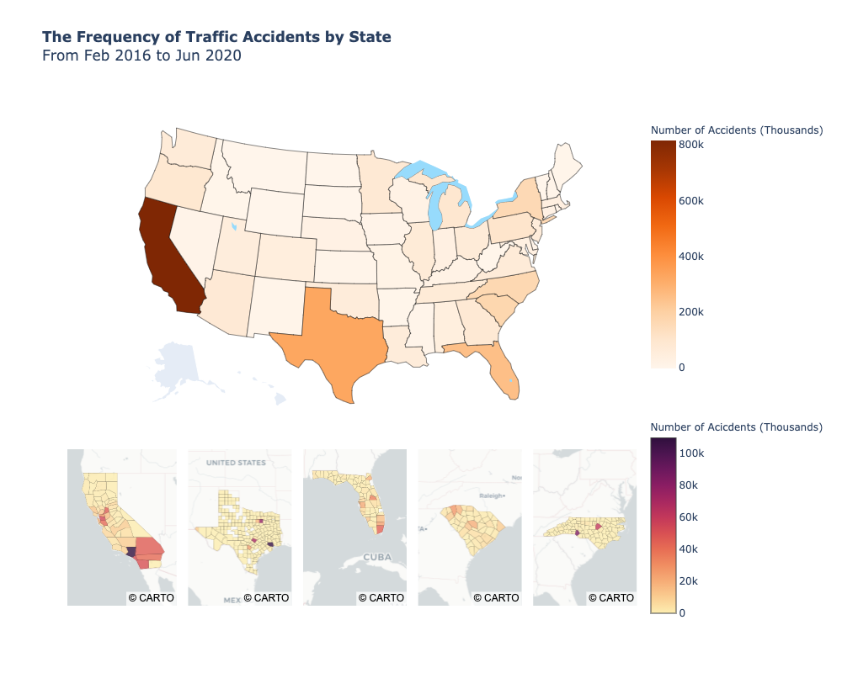
Data Exploration, Alalysis and Visualization Location Analysis
The Frequency of Traffic Accidents by State
According to state distribution, California, Texas, and Florida had the highest traffic accidents between February 2016 and June 2020. Of those, about 810,000 were in California, with more than about 270,000 in Los Angeles County. After California, the state with the most accidents in Texas, with nearly half a million. Harris County alone accounts for one-fifth of all traffic accidents in the state. Traffic accidents are not evenly distributed across the state and tend to be concentrated in individual, densely populated counties. For example, several counties in Southern California account for most of the traffic accidents that occur in California.

Slide 12
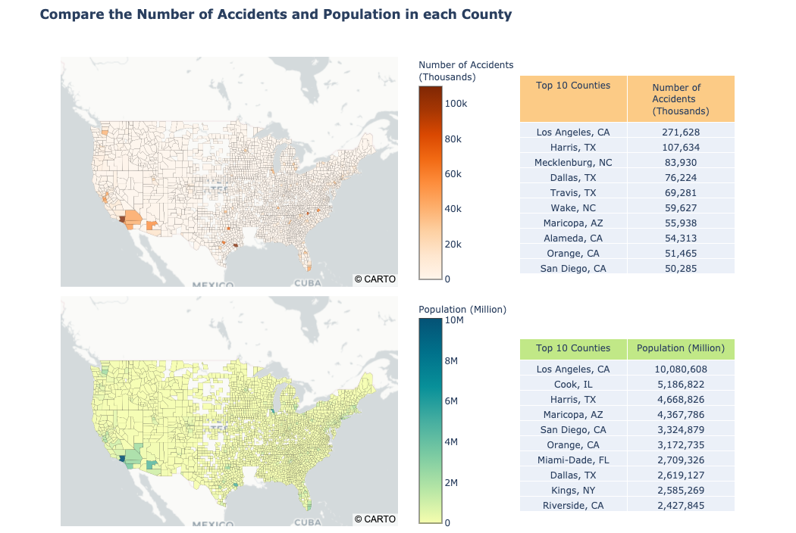
Data Exploration, Alalysis and Visualization Location Analysis
Compare the Number of Traffic Accidents and Population in each County
As shown in the comparison graph above, traffic accidents in the United States are unevenly distributed, with most accidents occurring in counties with large populations.

Slide 13
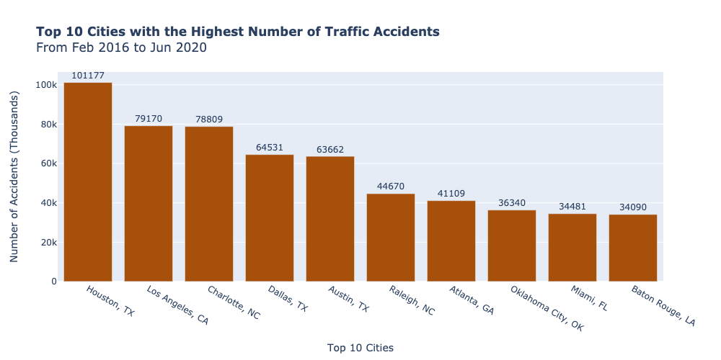
Data Exploration, Alalysis and Visualization Location Analysis
The 10 Most Frequent Traffic Accidents Cities in the United States
Between February 2016 and June 2020, these top 10 cities had the most traffic accidents. These ten cities alone account for 16% of all traffic accidents in the United States.

Slide 14
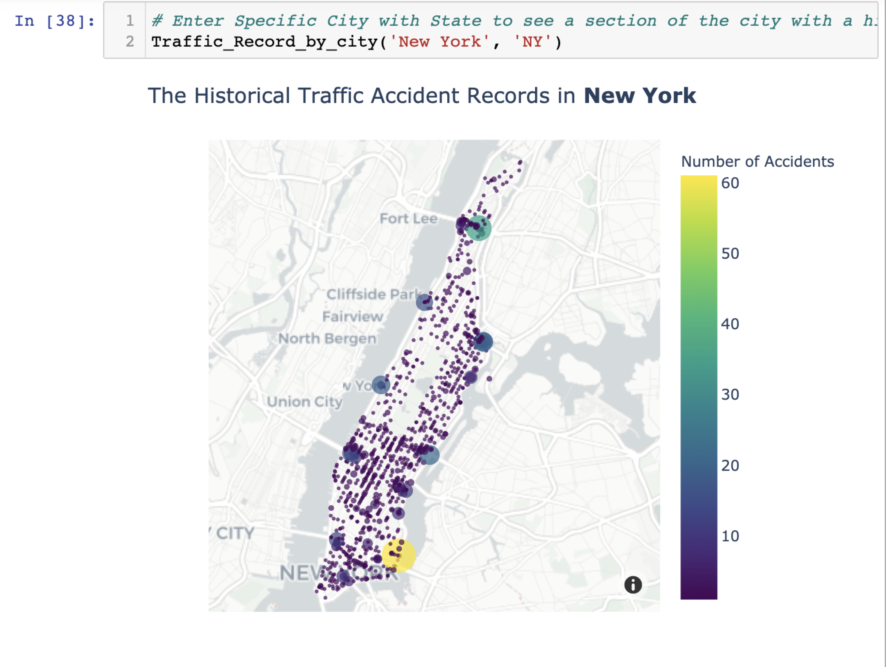
Data Exploration, Alalysis and Visualization Location Analysis
An Interactive Search of Traffic Accident Prone Sections of the City
Search traffic accident records in a particular city to see where traffic accidents occur frequently.

Slide 15
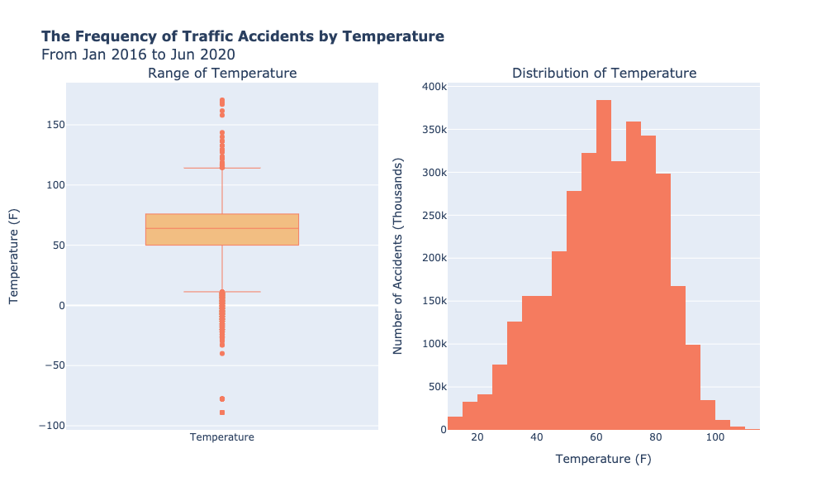
Data Exploration, Alalysis and Visualization Weather Analysis
The Frequency of Traffic Accidents by Temperature
Based on traffic accident records from February 2016 to June 2020, the weather temperature at the time of the accident ranged from -89F to 170F. Fifty percent of the accidents occurred in temperatures between 50F and 75F. Traffic accidents happen most frequently when the weather temperature is between 60-65 degrees and 70-75 degrees.

Slide 16
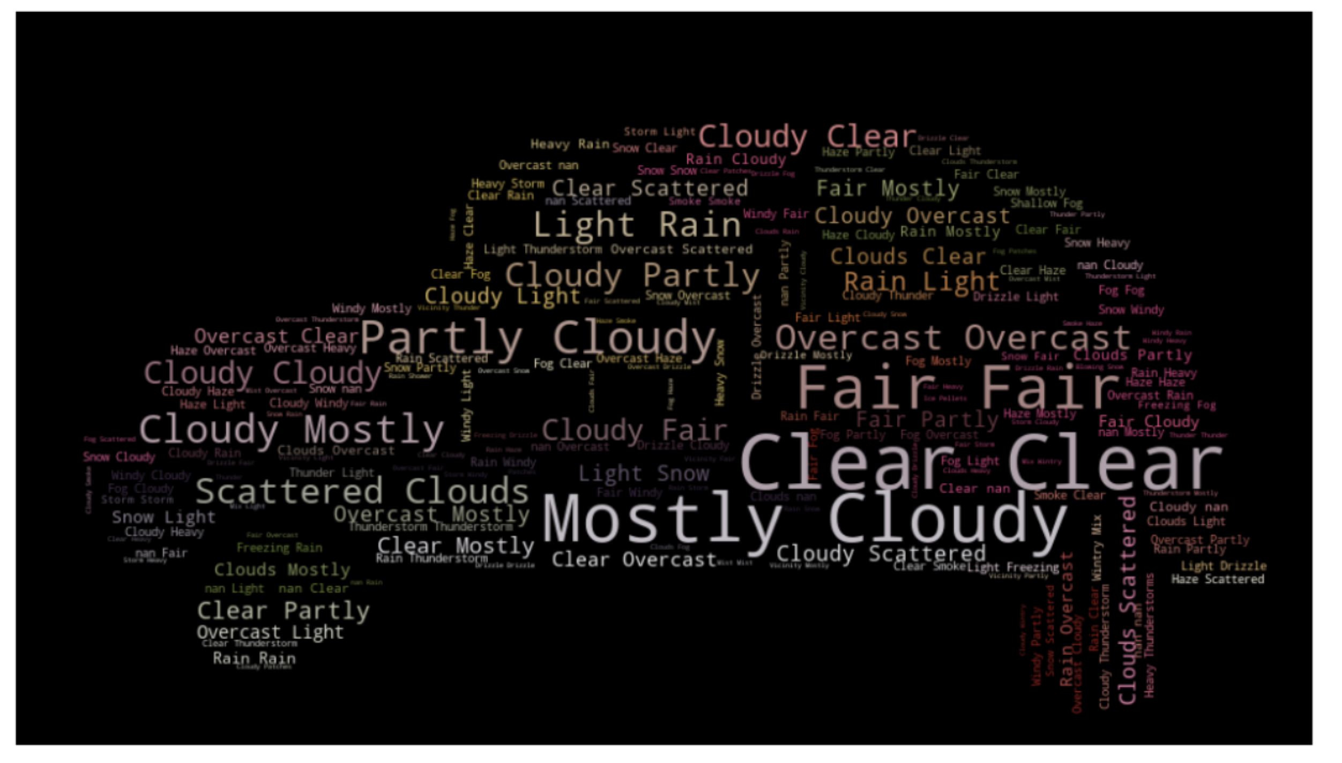
Data Exploration, Alalysis and Visualization Weather Analysis
The Weather Condition with the Most Frequent Traffic Accidents
Traffic accidents happen most often in the United States when the weather is clear, mostly cloudly and fair.

Slide 17
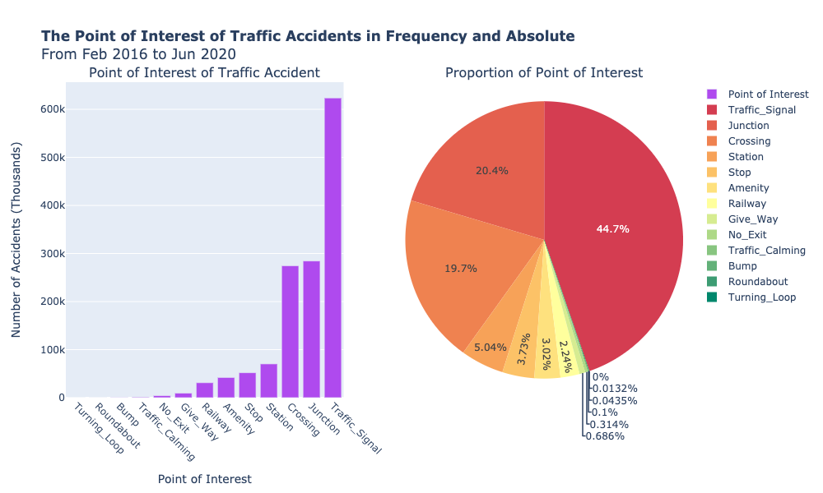
Data Exploration, Alalysis and Visualization Point of Interest Analysis
The frequeny of Traffic Accidents by Point of Interest from Feb 2016 to Jun 2020
Nearly 45% of all traffic accidents in the United States occur near the traffic signal. Accidents at junction and crossing are also common. It is much less involved in traffic accidents in the neighborhood of traffic calming, bump, no exit, and give way.

Slide 18
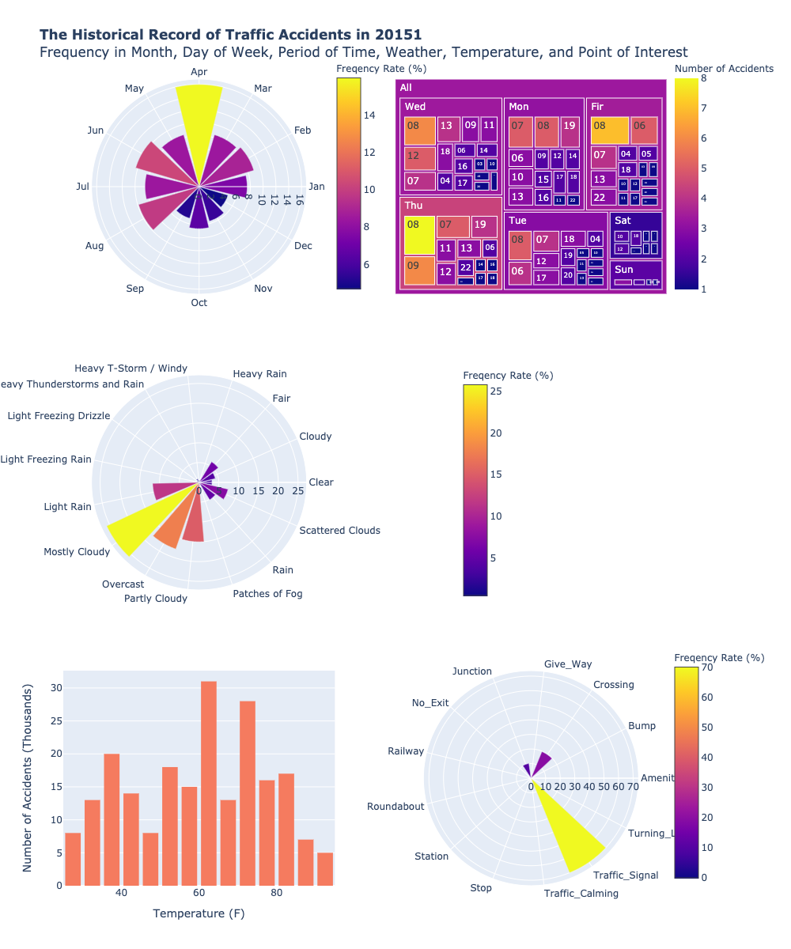
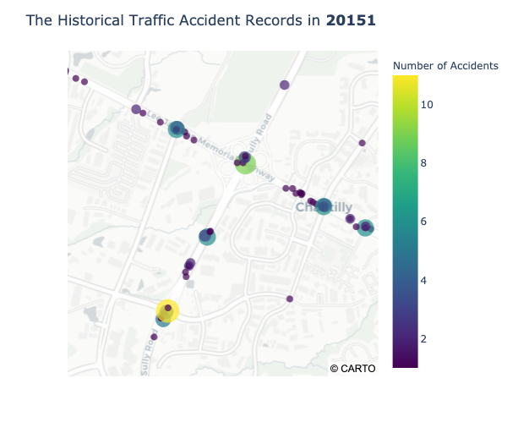
Data Exploration, Alalysis and Visualization
Interactively Retrieves the Historical Traffic Accidents Record of a Particular Zipcode
Retrieving traffic accident records for a particular zip code generates a statistical visualization report of all historical traffic records for that Zipcode, including the month of frequent traffic accidents, day of the week with time, weather conditions, temperature, point of interest, and maps of specific locations and sections with frequent traffic accidents.

Slide 19
Conclusion
According to historical records, the number of traffic accidents in the United States is increasing every year. Even though this year has been affected by the epidemic and many places have imposed travel restrictions, the number of traffic accidents in the first half of this year is still up by nearly 100,000 compared with the same period last year. Drivers should pay special attention to driving in June and October, and on the 12th and 13th of each month. On weekdays, heavy rush-hour traffic is also likely to cause traffic accidents. Be careful when drivers travel near the weekend on Friday and 1 or 2 p.m. on Saturday and Sunday. Watch out for safe and careful driving on winter nights. Drivers should be careful not only in extreme weather but also in the case of clear or cloudy weather.
Traffic accidents are unevenly distributed across the United States and frequently occur in states, counties, and cities with large populations. Los Angeles, California; Houston, Texas; and Charlotte, North Carolina were the places with the most accidents. Travelers should pay special attention to driving safety if they go to these cities or other cities with large populations. Accidents frequently occur near traffic signals, junctions, and crossing. Increasing the facilities of traffic calming and give way signs will significantly reduce the incidence of traffic accidents.
The traffic accident records of a particular city can be interactively retrieved to see the location and road section of specific traffic accidents. Drivers can be vigilant to avoid traffic accidents while traveling along these roads. Traffic accident records of a particular zip code can also be interactively retrieved to see frequent traffic accident months, day of the week with time, weather conditions, temperature, point of interest, and specific locations and road maps of frequent traffic accidents under this zip code. Besides, the police can also allocate patrol police through this search tool to make the most effective police resources use.

Slide 20
Learning Processes
I used many subplots to show several associated attributes better and get more detailed information. Because this dataset is about traffic accidents, I think the map can intuitively show the detailed information of specific locations, so many maps were used in this project. Because the dataset is large enough, the report generated by interactive retrieval in this project also has an absolute reference value. Compared with the previous two projects, I was more comfortable using various types of visualization in projects.

Slide 21
References
US-Accidents: A Countrywide Traffic Accident Dataset. (2020, July 01). Retrieved December 15, 2020, from https://smoosavi.org/datasets/us_accidents
Natural Resources Conservation Service. (n.d.). Retrieved December 15, 2020, from https://www.nrcs.usda.gov/wps/portal/nrcs/detail/national/home/?cid=nrcs143_013697
Bureau, U. (2020, June 22). County Population Totals: 2010-2019. Retrieved December 15, 2020, from https://www.census.gov/data/datasets/time-series/demo/popest/2010s-counties-total.html
(n.d.). Retrieved December 15, 2020, from https://raw.githubusercontent.com/python-visualization/folium/master/tests/us-counties.json
Moosavi, Sobhan, Mohammad Hossein Samavatian, Srinivasan Parthasarathy, and Rajiv Ramnath. “A Countrywide Traffic Accident Dataset.”, arXiv preprint arXiv:1906.05409 (2019).
Moosavi, Sobhan, Mohammad Hossein Samavatian, Srinivasan Parthasarathy, Radu Teodorescu, and Rajiv Ramnath. “Accident Risk Prediction based on Heterogeneous Sparse Data: New Dataset and Insights.” In proceedings of the 27th ACM SIGSPATIAL International Conference on Advances in Geographic Information Systems, ACM, 2019.

